Slide 1
HL ONLY
TOPIC A4:
MACHINE LEARNING
LESSON A4-4
FEATURE SELECTION

Slide 2
AGENDA
Warm up
What a feature is
Feature selection
How many subsets are there
Filter methods
Wrapper methods
Embedded methods
Choosing a strategy
The curse of dimensionality
Sparsity and sample size
Lab
Close
WHAT U NEED 4 LESSON
Guided Notes
ur hedz

Slide 3

WARM UP QUESTION
(a) State what normalization does to a column [1]
(b) A column runs from 0 to 200. Calculate the normalized value of 50. Show your working. [1]
(c) State one reason a distance-based algorithm needs its columns on the same scale [1]
→ Notes Q1 (a), (b), (c)

Slide 4
WARM UP ANSWER
(a) It rescales the column so the smallest value becomes 0 and the largest becomes 1
(b) (50 − 0) ÷ (200 − 0) = 0.25
(c) Otherwise the column with the biggest raw values decides the distance almost on its own, whatever its units happen to be

Slide 5
WHAT A FEATURE IS
A feature is one column of your data set - one measurable attribute of every example
Height, shoe size, etc. are features
  One row (or record) should have one value for each of them

Slide 6

WHAT A FEATURE IS
The number of features determines the number of dimensions the data sits in
Two features is a graph you can draw on the board, but 40 features creates 40 dimensions of complexity (yikkers)
Last lesson we looked at what makes a value in a column valid or invalid, but today we look at how useful those columsn are
→ Our sheet: how many features does our class data set have?

Slide 7
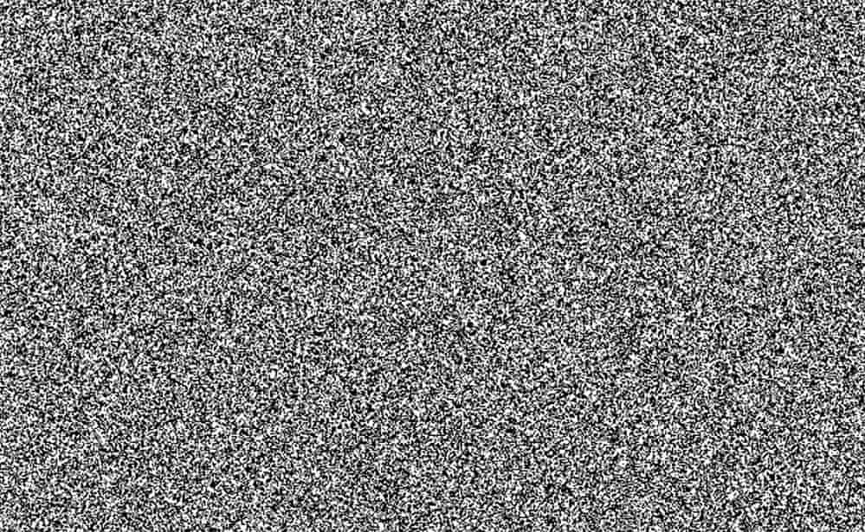
FEATURE SELECTION
Feature selection means keeping the most informative columns and deleting the rest
  You don’t create new columns or change the values in any column
A column should be kept if it tells you something about the value you’re trying to predict
  A column that has nothing to do with the answer is called noise
  The problem is that a model will still attempt to find a pattern in the noise, which is moreso a coincidence in your training data, leading to an inaccurate model
→ Our sheet: if we were predicting shoe size, which column looks most useful? Which one looks like noise?

Slide 8
FEATURE SELECTION
Fewer columns leads to faster training and a smaller model file
  Also much easier to understand lol
It also means less overfitting - a model memorising coincidences instead of learning a rule
But there is a risk to cutting a column that mattered which will make the model worse
  There is no magic formula that tells you which columns matter
But, there are three strategies…
→ Notes Q2 (a) and (b)

Slide 9

HOW MANY SUBSETS ARE THERE
For every column we decide to keep it, or drop it
Four columns is four yes-or-no decisions, which is a truth table with 2⁴ = 16 rows
  Every row of that table is a different data set you could build
Keep is 1 and drop is 0, the same way you built truth tables in Topic A1
  Of course, one of those is a row with all zeroes, which wouldn’t give us much of a model, so 15 viable options

Slide 10
HOW MANY SUBSETS ARE THERE
The first four rows and the last one
→ Notes Q3 (a) — fill in the rest
Height | Shoe | DOB | Color | What you would train on
0 | 0 | 0 | 0 | nothing at all
0 | 0 | 0 | 1 | Color
0 | 0 | 1 | 0 | DOB
0 | 0 | 1 | 1 | DOB + Color
... | ... | ... | ... | ...
1 | 1 | 1 | 1 | everything

Slide 11
HOW MANY SUBSETS ARE THERE
4 columns is 16 rows
  10 columns is 1,024, and 20 columns is 1,048,576
A strategy that tests every possible combination has to train a model for row on that truth table
At one second per model, twenty columns is twelve days of computing
  At one minute per model, it is two years
    Which is to say, this is a terrible idea
It’s generally ill advised to try to use the whole table, and to test every combination
  Ooh! What’s the big O efficiency of this algorithm?
→ Notes Q3 (b) and (c)

Slide 12
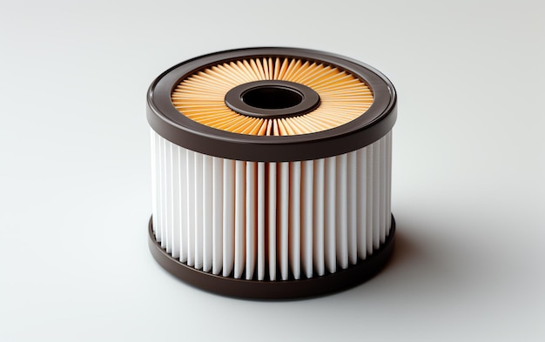
FILTER METHODS
A filter method scores each column’s worth on its own before a model exists
  Typically, this is how strongly the column moves with the value you are predicting
Keep the highest scoring features, and drop the rest, creating your training data set
It is cheap and fast, there’s no training involved in the process until the final training is ready to occur
It is also model-blind: it has no idea which algorithm you are about to use it with
→ Our sheet: which column would you expect to move with shoe size?

Slide 13
FILTER METHODS
The weakness is that it judges one column at a time
  This means that two columns that say the similar things both score well, so you keep both, which will increase the weight of that data
    Imagine if we had a height (in) and a height (cm)
Also, two columns that look useless alone can be informative together, and a which filters miss
  Such as height and weight together creating BMI
Use filter methods when you have hundreds of columns and need to get down to a smaller number quickly
→ Notes Q4 (a) and (b)

Slide 14
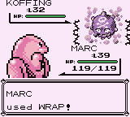
WRAPPER METHODS
A wrapper method trains the model on a subset of columns and scores how well it did
Then it tries a different subset and keeps whichever one performed better
This strategy judges things by performance in a finished model – what matters most
This can detect combinations because it is testing whole sets rather than single columns
But every possible option created requires a full training run (boo!)

Slide 15


WRAPPER METHODS
Recall that it’s unviable to try all 2^{n} subsets
  Forward selection starts with nothing and adds the column that helps most, one at a time
  Backward elimination starts with every feature and removes the column that harms the results the least
Both algorithms end when the score stops improving, but neither strategy is guaranteed to find the best subset
Use it when you have the plenty of computing power and time, and are attempting to drain your neighborhood of all water and electric resources
→ Notes Q5 (a) and (b)

Slide 16
EMBEDDED METHODS
An embedded method does the selecting inside training, as part of building the model
  This is NOT a separate selection step
  One training run produces both the model and the choice of columns
One example of this is a decision tree: it picks which column to split on at every branch, not using columns it doesn’t select at the splits
Another example is regularized regression: it shrinks the weight on a weak column toward zero until that column ends up not contributing

Slide 17
EMBEDDED METHODS
These are usually more time and cost effective than a wrapper
  The selection comes free with the training you were doing anyway
This is more complete than the filter strategy because it can notice combinations
The catch is that the choice belongs to that one algorithm, like the decision trees, or the regularized regression
If you swap the algorithm and you may get a completely different set of columns back
→ Notes Q6 (a) and (b)

Slide 18
CHOOSING A STRATEGY
ANOTHER TRADEOFF
→ Notes Q7
 | Cost | Sees combinations? | When to use it
Filter | Lowest | No | Hundreds of columns, little time
Wrapper | Highest | Yes | Accuracy matters most
Embedded | Middle | Yes | Default for trees and regression

Slide 19
THE CURSE OF DIMENSIONALITY
Dimensionality reduction is what we call cutting the number of columns while keeping the information the data was telling you
The curse of dimensionality is what we call all of the issues that arise as more and more columns are added to a dataset
  It’s contributed to by 7 smaller problems that we’ll talk about here
    (except for principal component analysis and linear discriminant analysis which they think are ‘bEyOnD tHiS cOuRsE’ (they are correct))
This means that you don’t have to do any math, but you do need to know why too many columns ends up being a bad idea

Slide 20
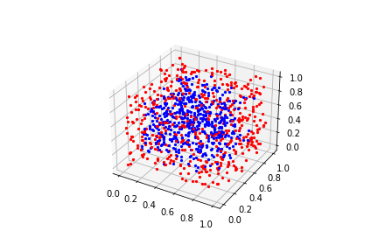
THE CURSE OF DIMENSIONALITY
Overfitting - more columns creates the opportunity to find correlations that are coincidental
Computational complexity - more arithmetic per example, in training and again at inference, slowing the model and training down
Memory usage - the data set itself gets bigger, and so does the model built from it
Data visualization - you can plot two columns, or three at a time if you really need to, but you cannot look at forty
These are the easy ones

Slide 21

THE CURSE OF DIMENSIONALITY
Effectiveness of distance metrics – remember how we used the distance formula last time?
  If you add enough columns, every pair of points ends up roughly the same distance apart
When everything is equally far from everything else, and k-NN stops working
  It’s like data alphabet soup
Normalizing the columns doesn’t help
  The issue is that there’s just so many columns they end up balancing everything out
→ Notes Q8 (a) and (b)

Slide 22
SPARSITY AND SAMPLE SIZE
How many people in this school are basically the same as you?
Sort by height into ten bands: 100 students, 10 bands, with 10 similarly heighted students in each
Add shoe size as another dimension - 10 × 10 = 100 boxes for the same 100 students, so statistically you might not be sharing a box with anyone
Add birthday month as another dimension - over 1,000 boxes, with at least 900, likely more, empty
Nobody joined or left, but ways to be different were added
We call this Data sparsity

Slide 23
SPARSITY AND SAMPLE SIZE
How many people in this school are basically the same as you?
k-NN finds the nearest examples and copies their answer
  That only works if somebody is actually near
  In 1,000 boxes with 100 students, your nearest neighbor might not share many similarities to you
Last lesson, distance broke because of scaling of values, and normalizing fixed it
  This time nothing fixes it except having fewer columns
→ Notes Q9 (a), (b) and (c)

Slide 24
SPARSITY AND SAMPLE SIZE
100 rows of data, 10 bins per column
→ Notes Q9 (a), (b) and (c)
Columns | Cells | Rows per cell | Rows needed for 10 to be in each cell
1 | 10 | 10 | 100
2 | 100 | 1 | 1,000
3 | 1,000 | 0.1 | 10,000
10 | 10,000,000,000 | basically zero | 100,000,000,000

Slide 25
LAB
→ Notes Q10 and Q11
Q10: A hospital has 60 columns of patient data and 400 patient records. Explain two problems that arise from training on all 60 columns. [4]
Q11: A team has 500 columns and almost no computing time before a deadline. Identify the feature selection strategy they should use and justify the choice. [2]

Slide 26

VOCABULARY TO REMEMBER
Feature
Dimension
Feature selection
Noise
Overfitting
Feature subset
Filter method
Wrapper method
Forward selection
Backward elimination
Embedded method
Dimensionality reduction
Curse of dimensionality
Data sparsity

